Slide 1

University Case study.
Made by : Nourhan Elsayed.

Slide 2

Agenda
DataBase erd.
PLSQL
Automation Scripts
Java Application.
End.

Slide 3
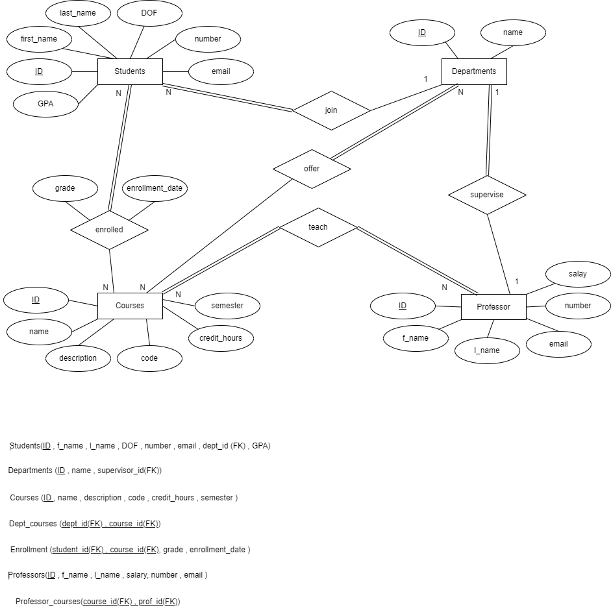
Database erd:

Slide 4
Mapping :
Students(ID , f_name , l_name , DOF , number , email , dept_id (FK) , GPA).
Departments (ID , name , supervisor_id(FK)).
Courses (ID , name , description , code , credit_hours , semester ).
Dept_courses (dept_id(FK) , course_id(FK)).
Enrollment (student_id(FK) , course_id(FK), grade , enrollment_date ).
Professors(ID , f_name , l_name , salary, number , email ).
Professor_courses(course_id(FK) , prof_id(FK)).

Slide 5


Plsql (procedures):
Add enrollment
used to register a student in a course
Add_new_couse
add new course in the table Courses
Assign_course_to_prof
assign a course to a professor through professor_courses table
Delete
first step it delete any enrollments in the enrollment table for the student.
Then to delete a student from Students table .

Slide 6

Plsql (package):
gpa_update_pkg
Calc_GPA
Add_student_to_update
Process_update_students
This function calculates cumulative GPA for a given student_id.
This procedure loop for students in stiudents_to_update and calculate their GPA.
This procedure takes a student_id as input and adds it to a table named students_to_update

Slide 7
Plsql(triggers):
Update_GPA trigger :
this trigger ensures that whenever there is an insertion or update in the "enrollment" table.
Add_grade_trigger :
this trigger ensure that the entered grade is one of the valid or the allowed grades format before inserting it in the enrollment table .

Slide 8
Automation scripts:
Disk Space Monitoring script :
Monitors disk space usage and sends an alert if it exceeds a specified threshold.
DataBase Backup script :
creating a database backup and logging the outcome of the backup operation to a log file.

Slide 9
Automation scripts:
System monitoring :
check_cpu(): Checks CPU usage and logs if it exceeds the threshold.
check_memory(): Checks memory consumption and logs if it exceeds the threshold.
check_disk(): Checks available disk space and logs if it falls below the threshold.
check_network(): Checks network traffic and logs if it exceeds the threshold.
check_db_connections(): Checks database connection failures and logs if it exceeds the threshold.

Slide 10

Java application :

Slide 11
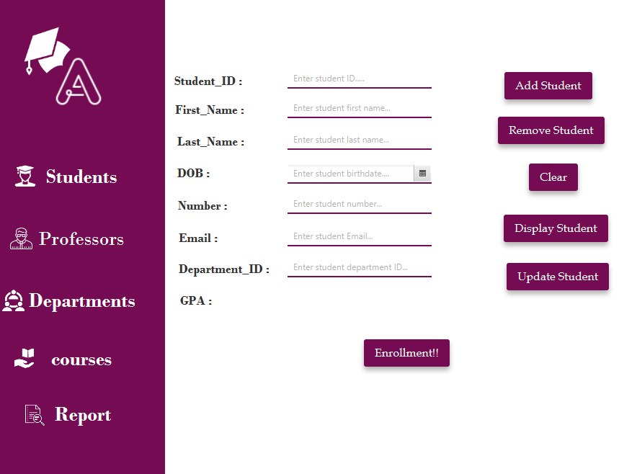
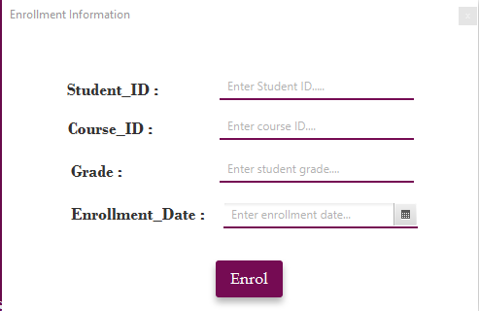
Java application (Student):

Slide 12
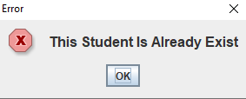
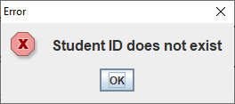
Java application (Student):
In case inserting new student with the same id taken by another one you will get alert
In case deleting , updating or requesting student data
that not exist you will get alert. .

Slide 13
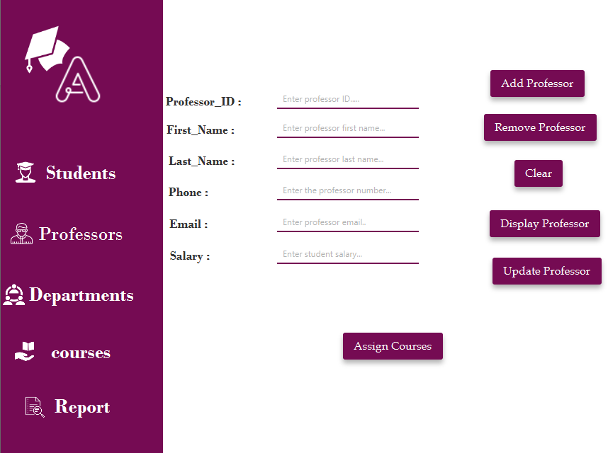
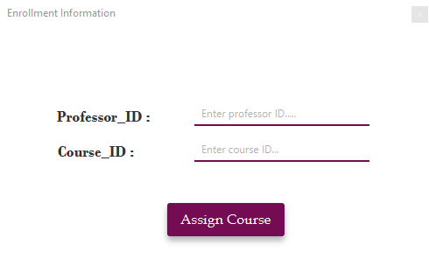
Java application(Professor) :

Slide 14
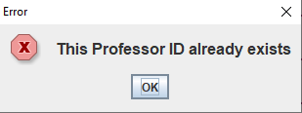
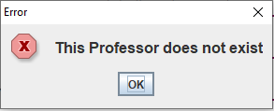
Java application(Professor) :
In case inserting new professor with the same id taken by another one you will get alert
In case deleting , updating or requesting professor data
that not exist you will get alert. .

Slide 15
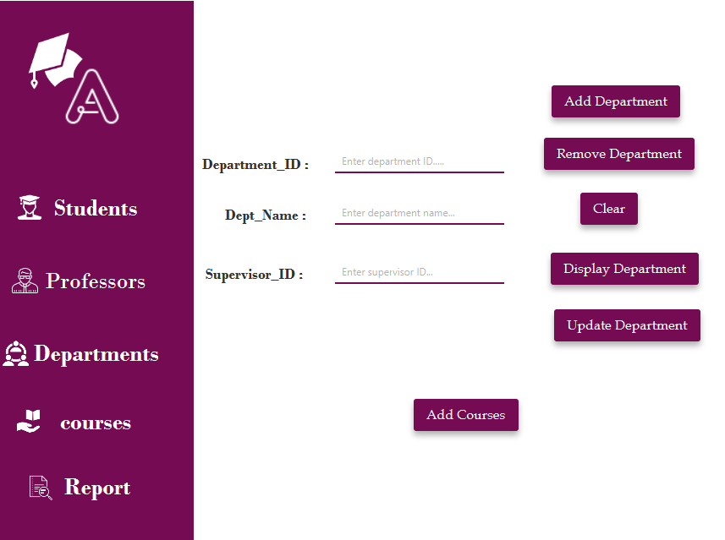
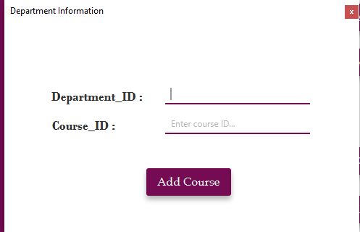
Java application (Department):

Slide 16
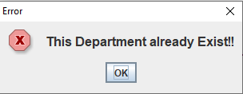
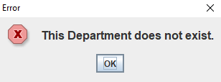
Java application (Department):
In case inserting new department with the same id taken by another one you will get alert
In case deleting , updating or requesting department data
that not exist you will get alert. .

Slide 17
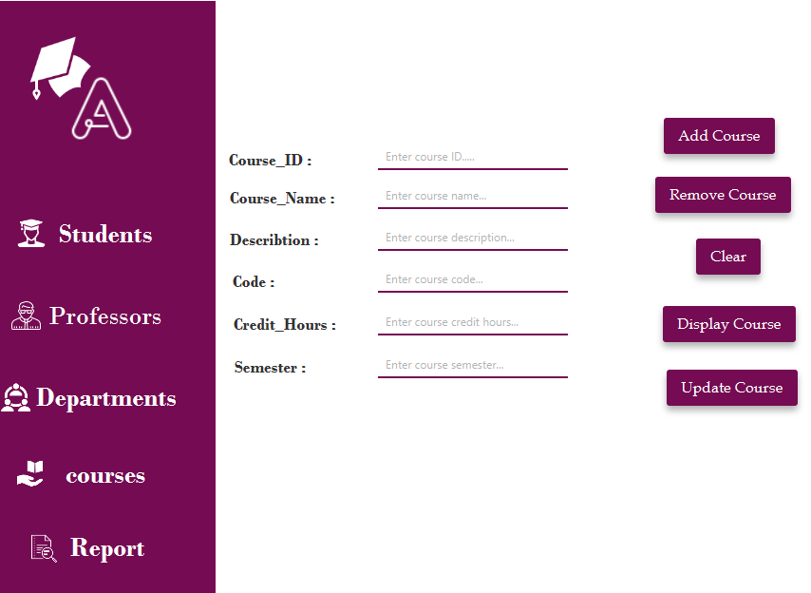
Java application(Course) :

Slide 18
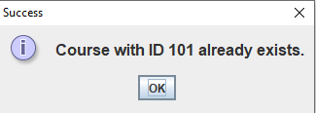
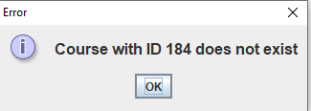
Java application(Course) :
In case inserting new course with the same id taken by another one you will get alert
In case deleting , updating or requesting course data
that not exist you will get alert. .

Slide 19
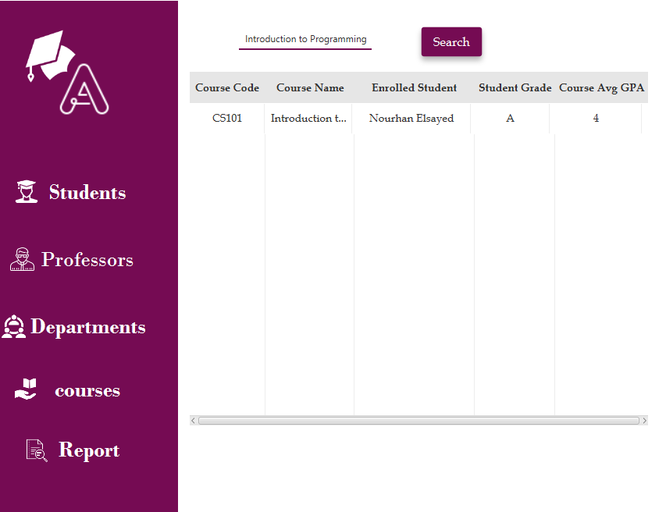
Java application(report) :

Slide 20

Thank you

